Slide 1
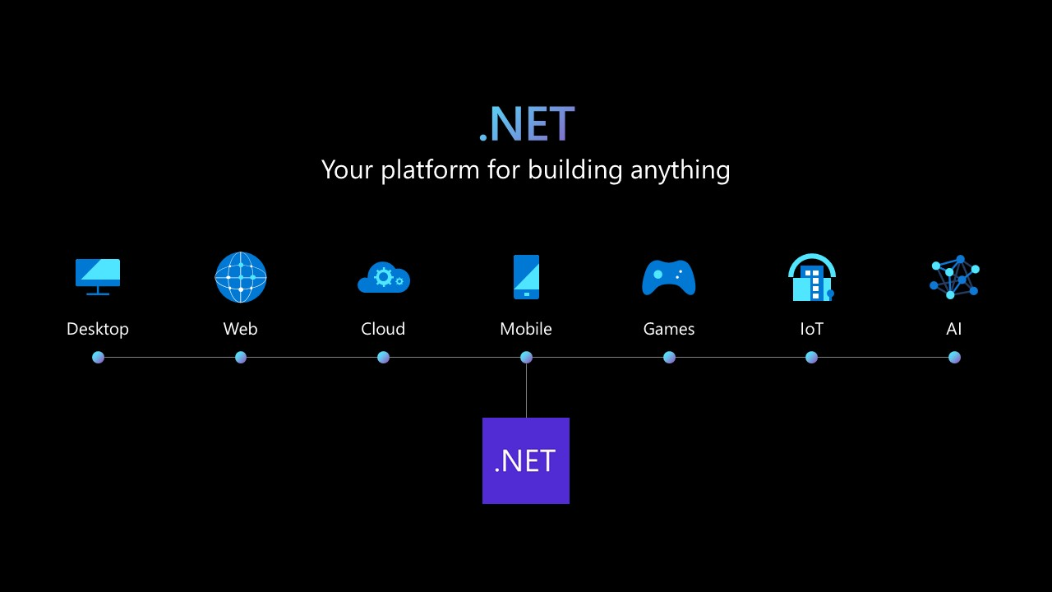
.NET NETWORK ENABLED TECHNOLOGIES
Created by:
TECH TITANS

Slide 2
WHAT IS .NET?
Microsoft .NET is a software development platform that helps developers build various applications and connect information, people, systems, and devices.
.NET provides:
A major architect tied to the success of .NET's key components is Anders Hejlsberg.
A runtime to execute programs
A huge library of ready-made functionalities
Support for multiple programming languages
Tools to build web, desktop, mobile, cloud, iot, and gaming applications

Slide 3
HISTORY OF .NET…
Pre-.NET technologies: Before .NET, Windows applications relied on technologies such as the Win32 API, VB6 (Visual Basic 6), and C++.
Drawbacks: These older technologies were characterized as hard to maintain, inconsistent, missing essential features like garbage collection, and complex for beginners.
2000 – .Net announced | Microsoft introduced the .Net framework, c#, and clr to simplify development and compete with java
2002 – .Net framework 1.0 | Released with CLR 1.0, base class library, ASP.NET, windows forms, and support for C# & VB.Net.
2016 – .Net core | Cross-platform, open-source, fast, and lightweight—runs on windows, linux, and macos.
2020 – .Net 5 | Unified .Net framework, .Net core, and xamarin into one modern platform.
Today – .Net 10 | Aunified, cross-platform, high-performance framework for web, mobile, desktop, cloud, and AI apps.

Slide 4

MICROSOFT C#
C# (pronounced c-sharp) is a modern, object-oriented programming language created by Microsoft for building powerful, safe, and high-performance applications on the .NET platform.
It is designed to be easy to learn, clean, and structured while offering advanced features for real-world software development.
C# provides:
A runtime to run your code
A library of ready-made functions
Tools to make development fast and easy

Slide 5
WHY .NET?
PROBLEM
HOW .NET SOLVED IT
Hard to build apps in older Windows technologies
No built-in memory management
No consistent language model
Windows-only limitations
Poor security
Need for fast, scalable apps
Provided unified library and runtime
Introduced Garbage Collection
Introduced CLS, CTS, CLR
Introduced .NET Core → Cross platform
Introduced Code Access Security
Modern JIT compiler, optimized runtime

Slide 6
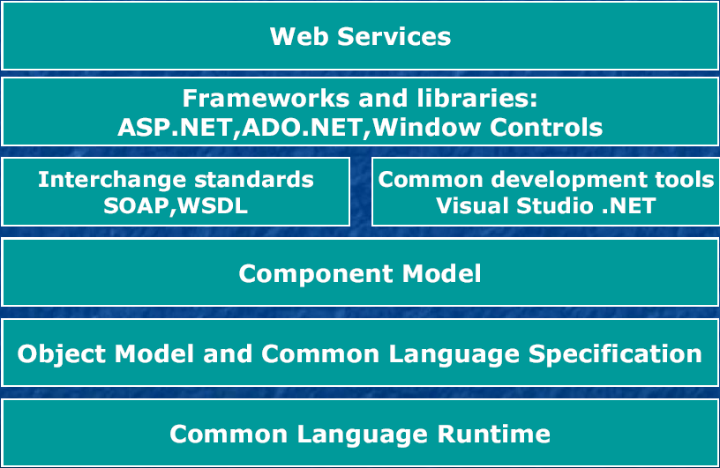
.NET ARCHITECTURE

Slide 7
.NET ARCHITECTURE COMPONENTS
01
02
03
CLR (Common Language Runtime)
The heart of .NET
BCL (Base Class Library)
A collection of ready-to-use features
Executes code
Manages memory
Handles security
Performs garbage collection
A collection of ready-to-use features:
Networking & Encryption
Collections (List, Dictionary)
Math & UI controls
WHY ONLY THESE LANGUAGES SUPPORT .NET?
Languages
All languages compile into MSIL/IL and run on CLR.
They follow CLS (Common Language Specification)
Rules for all .NET languages.
They compile to IL (Intermediate Language)
Then CLR executes it.
They follow CTS (Common Type System)
So a class written in C# can be used in VB.NET and vice versa.
C# & F#
VB.NET
Powershell
IronPython & IronRuby

Slide 8
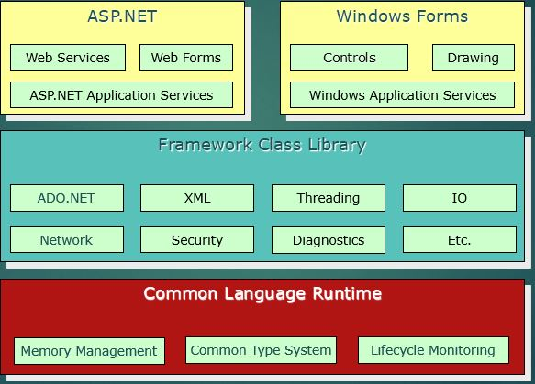
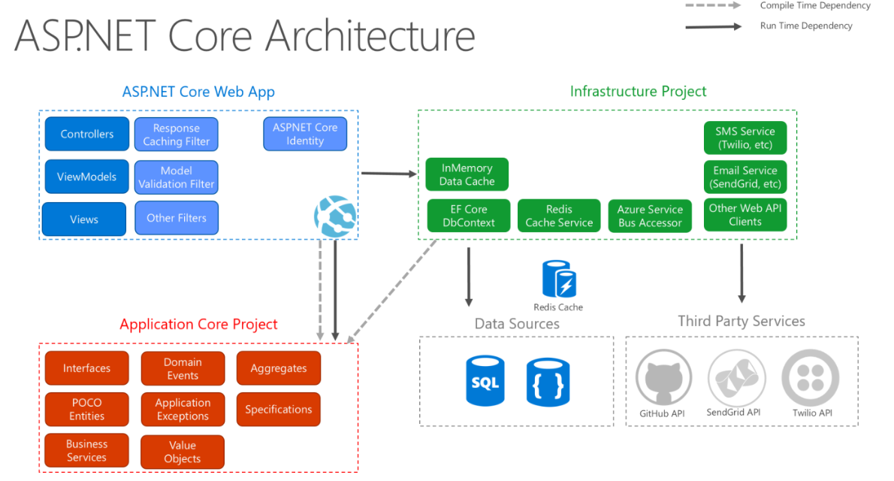
.NET FRAMEWORK
.NET CORE
Platform Support: The .NET Framework is restricted to Windows. Architecture and Performance: The .NET Framework uses a heavier, more monolithic architecture for stable Windows apps
Platform Support: The .NET Core is cross-platform, running on Windows, macOS, and Linux. Architecture and Performance: The .NET Core is modular and lightweight, designed for high performance in modern, cloud-based applications.

Slide 9
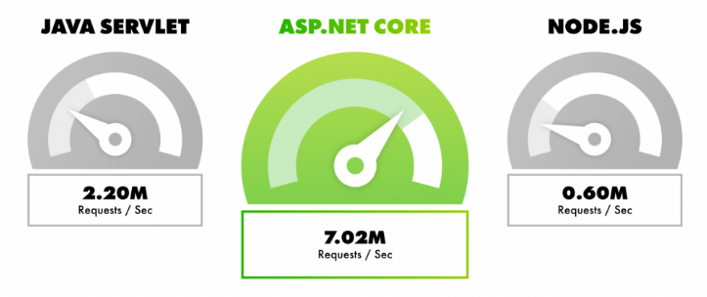
PERFORMANCE & BENCHMARK
The high performance of .net is a result of continuous optimization across the entire stack:
Dynamic profile – guided optimization Native Ahead of time(AOT) compilation .Net among top 3 fastest backend technologies Kestrel server performance

Slide 10
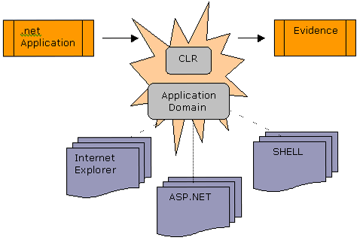
.NET SECURITY
.Net security = protecting your app + protecting your data + protecting your users + protecting your machine.
The .NET security framework architecture consists of the following five core elements:
Evidence Based Security
Code Access Security
Verification
Role Based Security
Cryptography

Slide 11
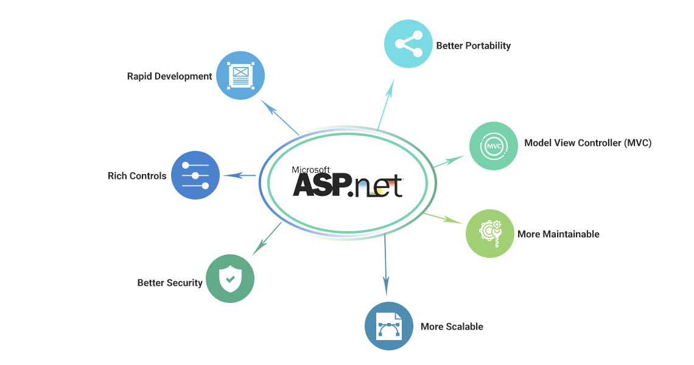
SUMMARY
Versatility: Allows developers to build virtually any type of application (web, mobile, desktop, cloud, or gaming).
Modernity: Utilizes modern tools and languages like C#.
Reliability: Guarantees continuous upgrades, strong performance, and cross-platform support.
Efficiency: Provides a complete ecosystem to create fast, scalable, and high-quality applications.

Slide 12
THANK YOU

